Slide 1
Electronic Store Website
Group 8: H2T Group

Slide 2



About us
Nguyen T. Thanh Hang
Nguyen Thu Huong
Bui Hanh Trang
20213570
20210423
20210851
A group tending to develop an Electronic Store Website that is friendly to users!

Slide 3
H2T
“Highly Higher Tech”
Value Proposition
Combination of members’ names
We don't just bring you technology; we bring you higher, better technology.
We tend to highlight smarter choices and advanced tech for users’ perfect purchase.

Slide 4
Final Report
01
02
03
04
Problem
Concept Video
Low-fi Prototypes
Med-fi Prototypes

Slide 5
User, problem and solution
01
Problem

Slide 6
Target users
Students
Office Workers
Offer gadgets tailored to their fields of study: providing a powerful laptop for programming, a tablet for original design or tools for efficient research,…
They often need reliable and advanced tech devices to increase productivity and improve work efficiency—and they want to stay connected in their busy lives.
and more…

Slide 7
Stakeholders
Direct
Indirect
Electronic companies
Schools
Students
E-commerce platforms
KOL/KOC in electronic fields
Sales
Ethical Implication
Sales can be fired and replaced by our websites.
Users can get the wrong answer and they will not believe in our web anymore.
Using our app too much can harm your eyes => using blue light to protect.

Slide 8
Problem
We are addressing the challenge of choosing the right electronic devices for your needs.
The overwhelming variety of options can be confusing; meanwhile features budgets and personal preferences must be balanced.
We objective to simplify this decision-making process by using a clever chatbot that gives personalized advice and makes technology shopping easy, informed and enjoyable.

Slide 9
Solution
We recognize that within our audience, there is a wide variety of preferences and levels of technological knowledge.
Some users want quick and simple suggestions, while others prefer in-depth advice tailored to specific needs.
Our chatbot aim to simplify electronics selection for all users, offering:
Personalized recommendations based on preferences, budget, and lifestyle.
Suggestions for work, gaming, studying, or entertainment.
Consultations for quick advice or detailed comparisons.
Community reviews and expert insights.
Wishlist and alerts for price drops or new arrivals.

Slide 10
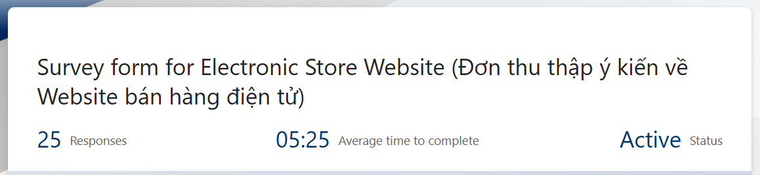
Interview, survey analysis
Interviewer
3 normal users: farmiliar shopping but not highly tech advance feature (office workers, normal students,…)
2 expert users: highly knowledge, experienced (IT major workers, gamer, streamer,…)
1 under extreme user: barely shopping online (older,…)
Survey filler
Can be anybody

Slide 11
Needs assessment
Friendly interface
Filter and recommendations
Users prefer simple design with as less pop up ads as possible
Users want general and personal recommendations without specific filter on technical information
Reliability
Reviews
Users often need insurance about product's quality
Users find spam reviews for sale are annoying, they want detail and authentic experience from other buyers

Slide 12
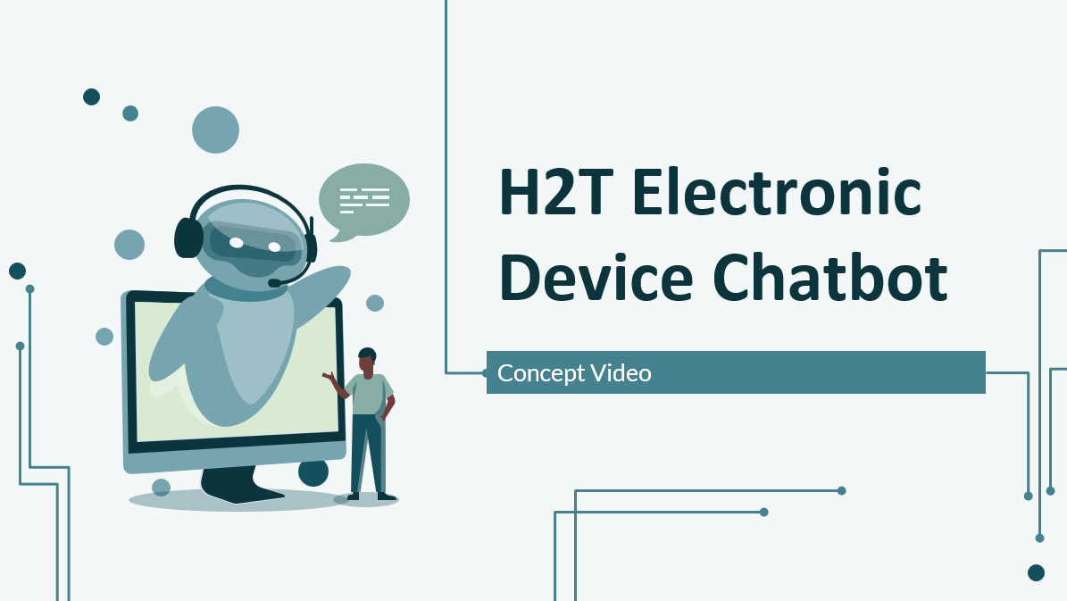
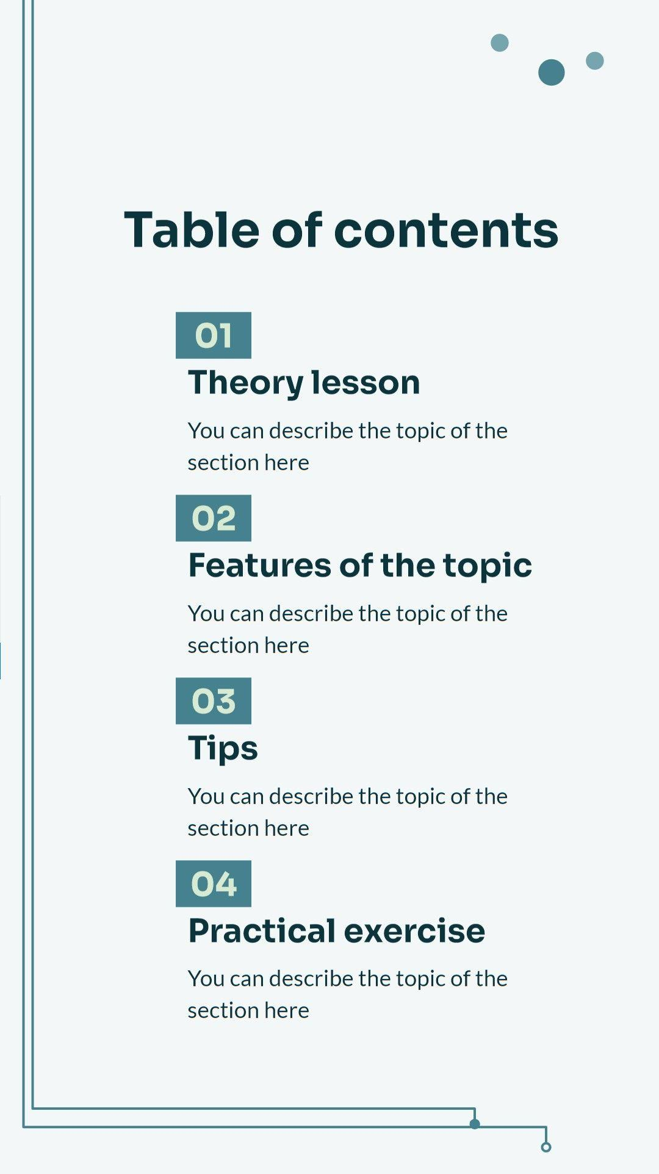



Concept Video
02
After comparing with 3 famous competitors, we conclude:

Slide 13
What we will take away
Responsive and user-friendly design:
Effective product presentation:
Adaptable layouts for various devices.
Personalizes user experience based on preferences and browsing behavior.
Clear, sharp visuals with consistent color themes and readable fonts.
Allows sorting products by multiple criteria (type, price, brand, etc.).
Intuitive filters to help narrow down choices.
Persistent carelist tracking products interest & updates even without login.

Slide 14
What we will enhance
Personalization & engagement:
Improve design and usability:
Integrate a chatbot for instant user support.
Chatbot sending updates of user products interest.
Organize product layouts more neatly to avoid a cluttered look.
Avoid overwhelming users with too many categories by simplifying navigation.

Slide 15
Storyboard
Bring the ideas to life

Slide 16
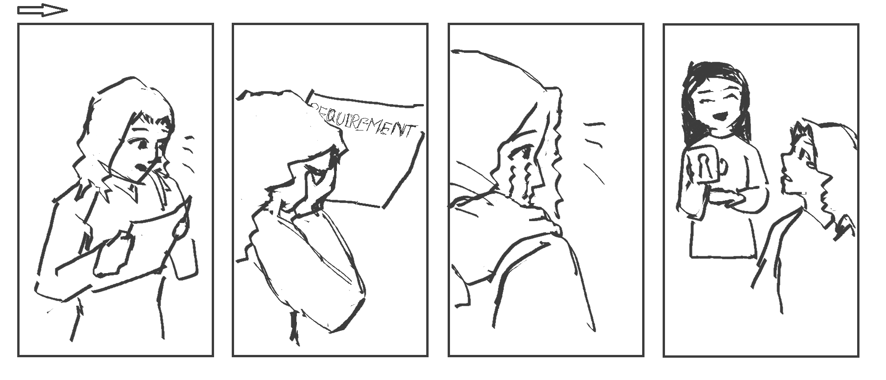
A girl who just got into ET-E16 receives the long list of necessary electrical equipments. She doesn't know what to buy
A classmate offers her a new e-commerce website comes with an AI chatbot which assists in recommendations

Slide 17
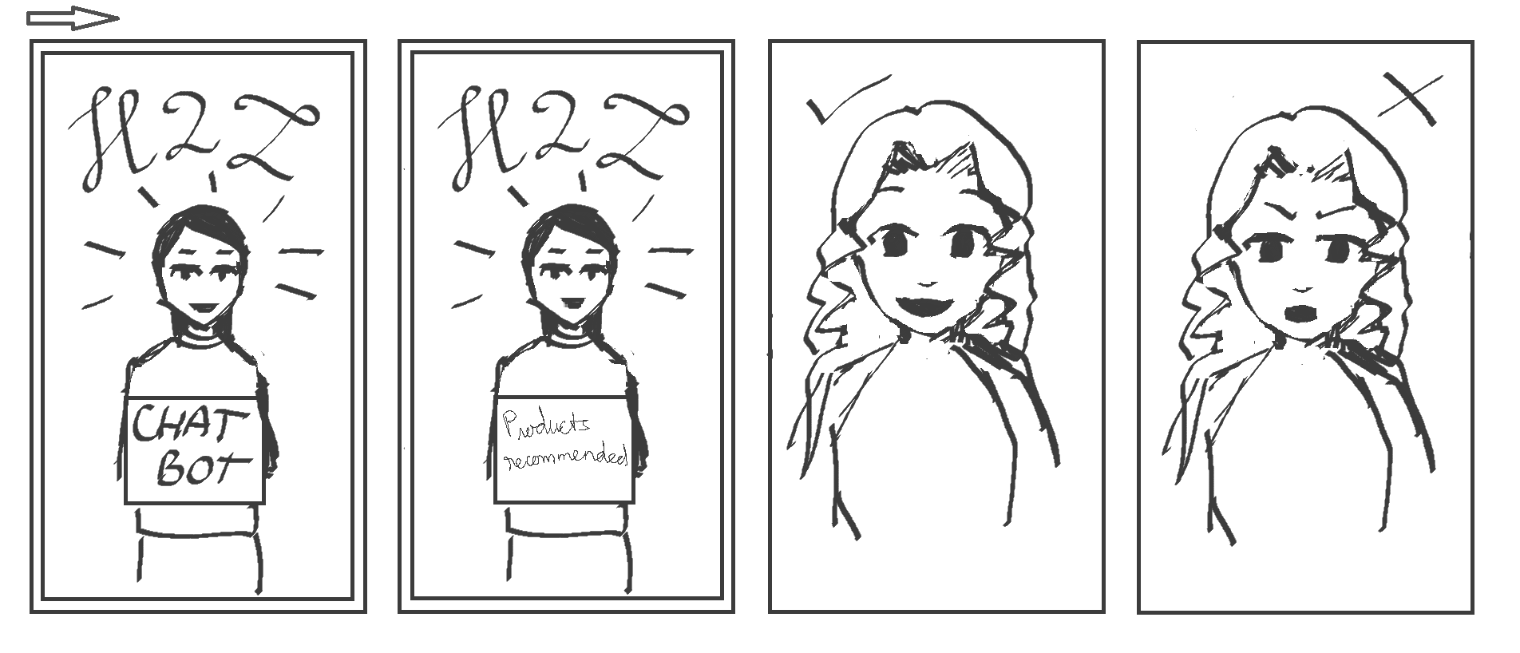
The chatbot gives recommendations base on the girl's requirements
The girl makes decisions depend on which product is given

Slide 18
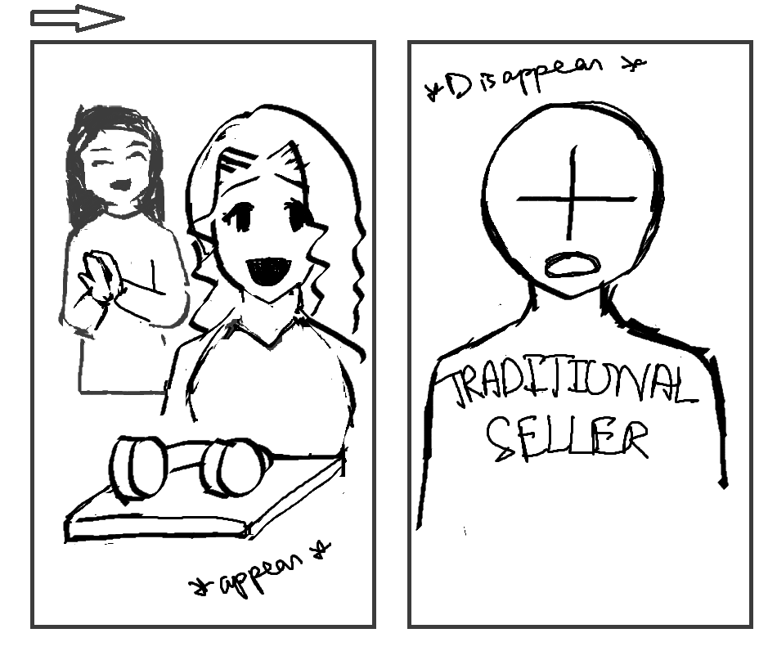
The chosen products appear before the girl
At the same time, traditional sellers disappear

Slide 19
03
Low-fi prototypes

Slide 20
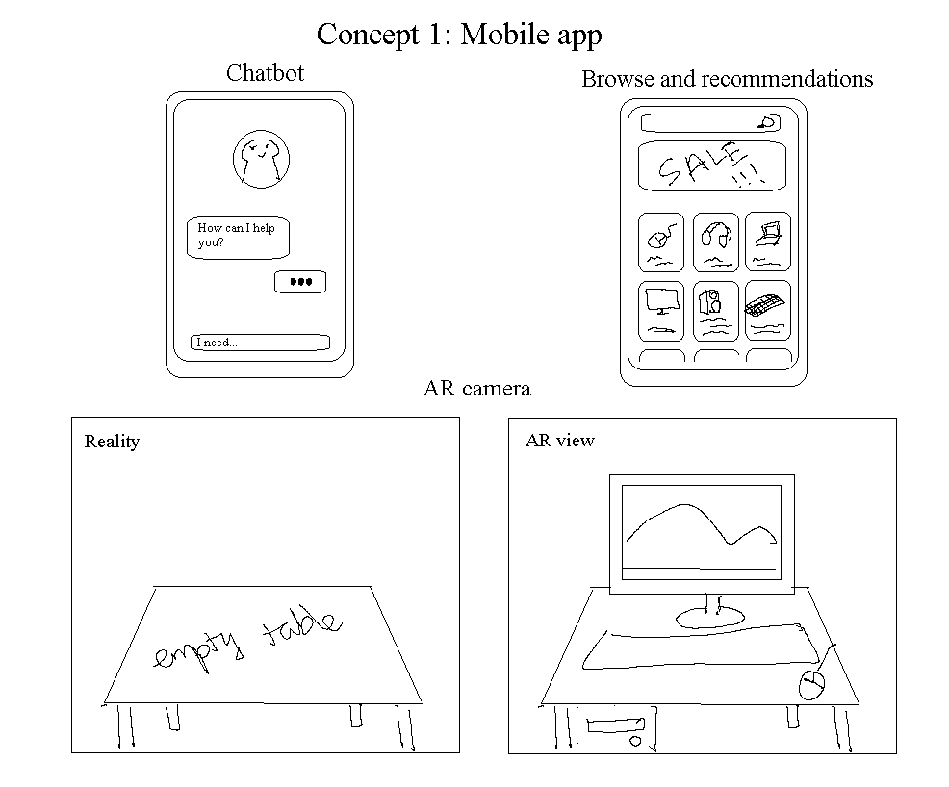
3.1. Mobile App

Slide 21
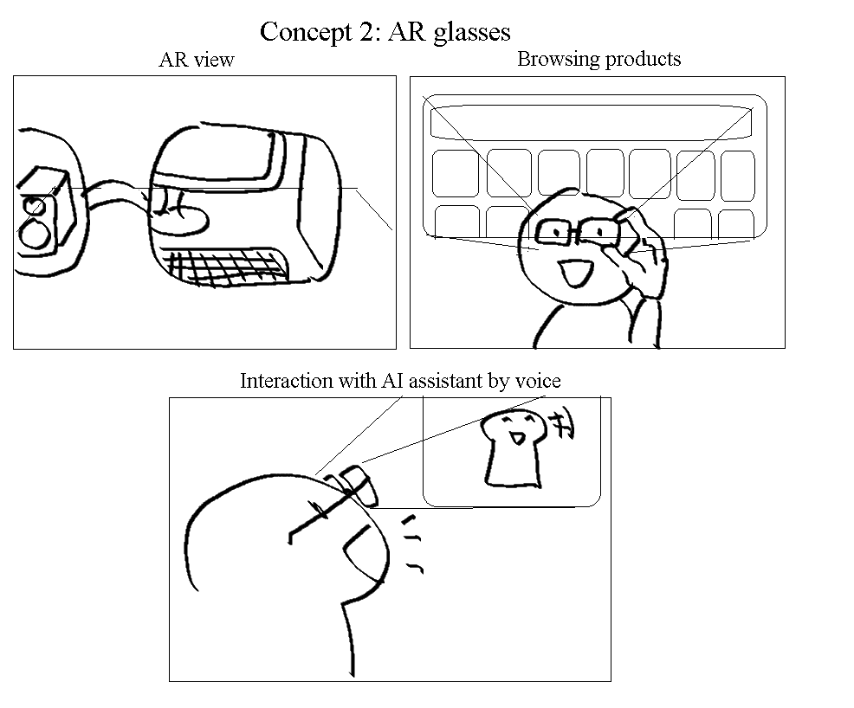
3.2. Smart/AR Glasses

Slide 22
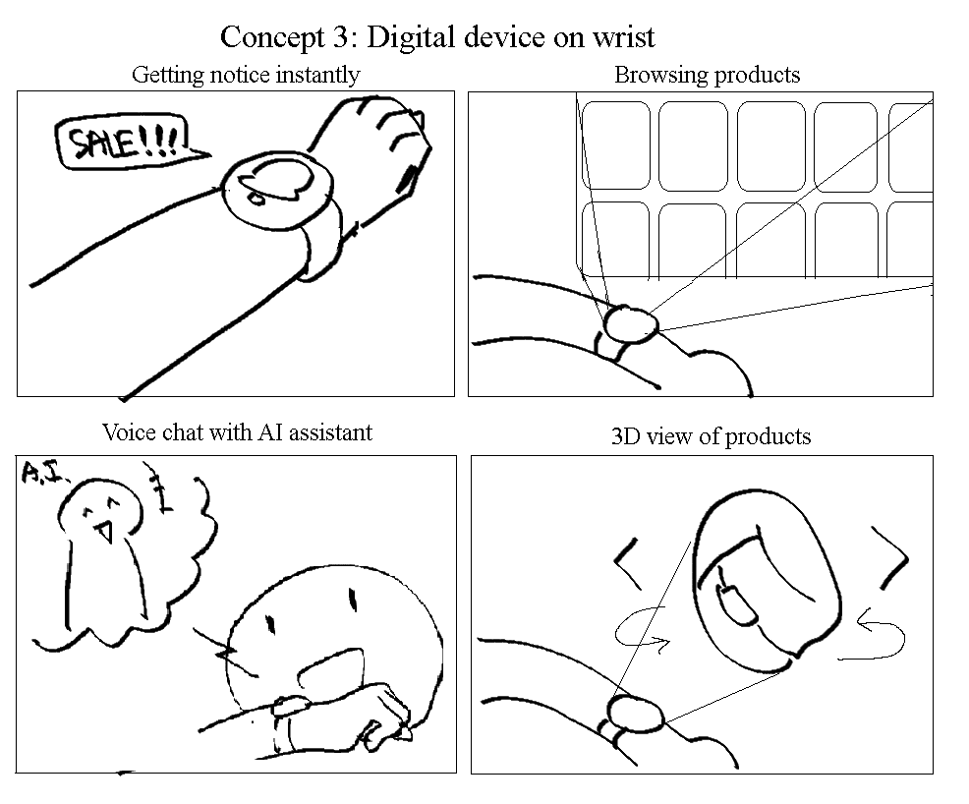
3.3. Smart Watch

Slide 23
FINAL SELECTIONS

Slide 24
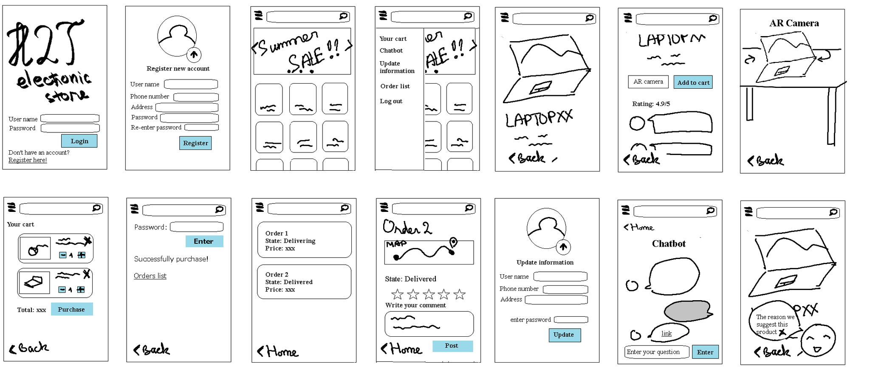
Low-Fi prototype constructions

Slide 25
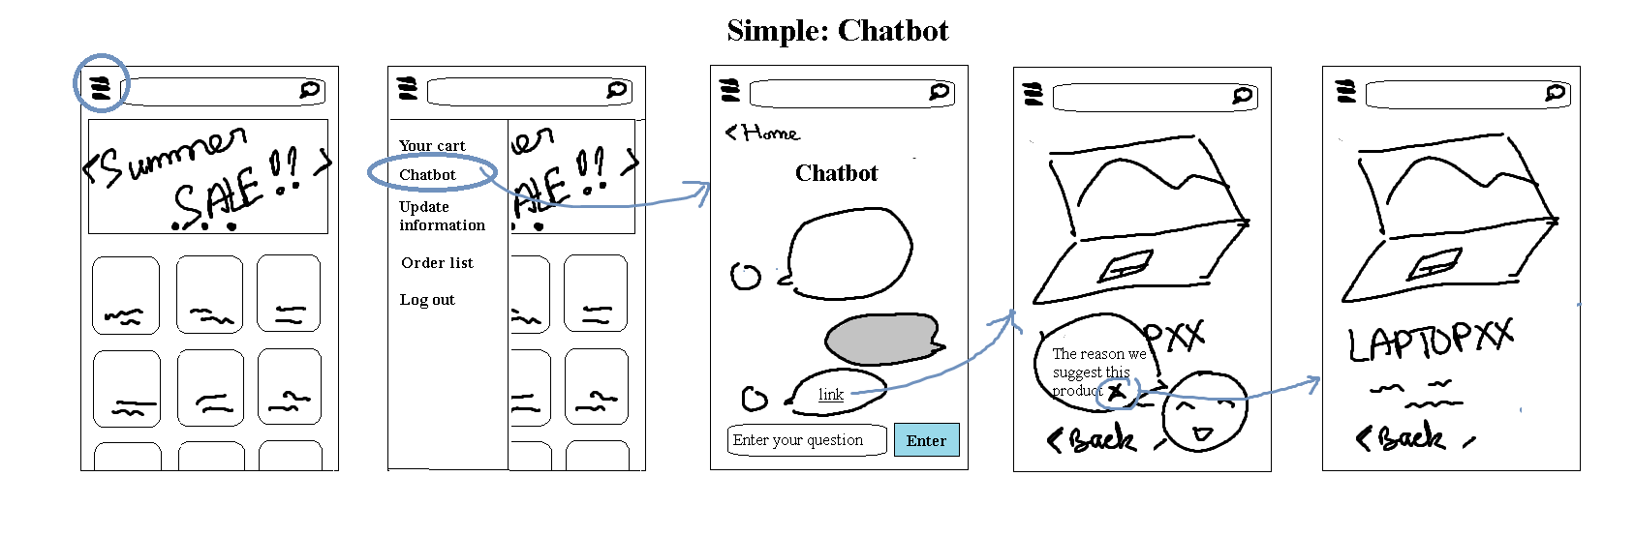
Simple: Chatbot

Slide 26
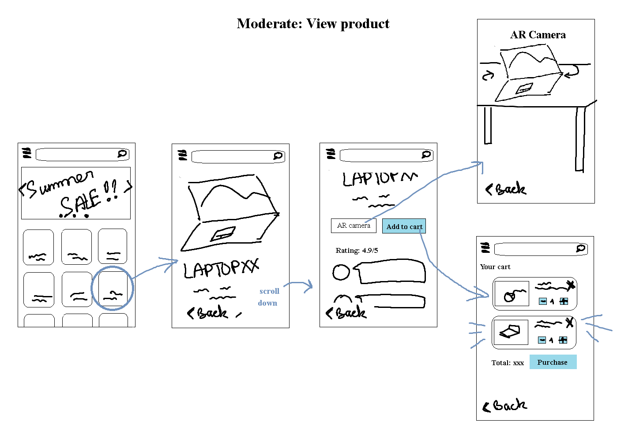
Moderate: View product

Slide 27
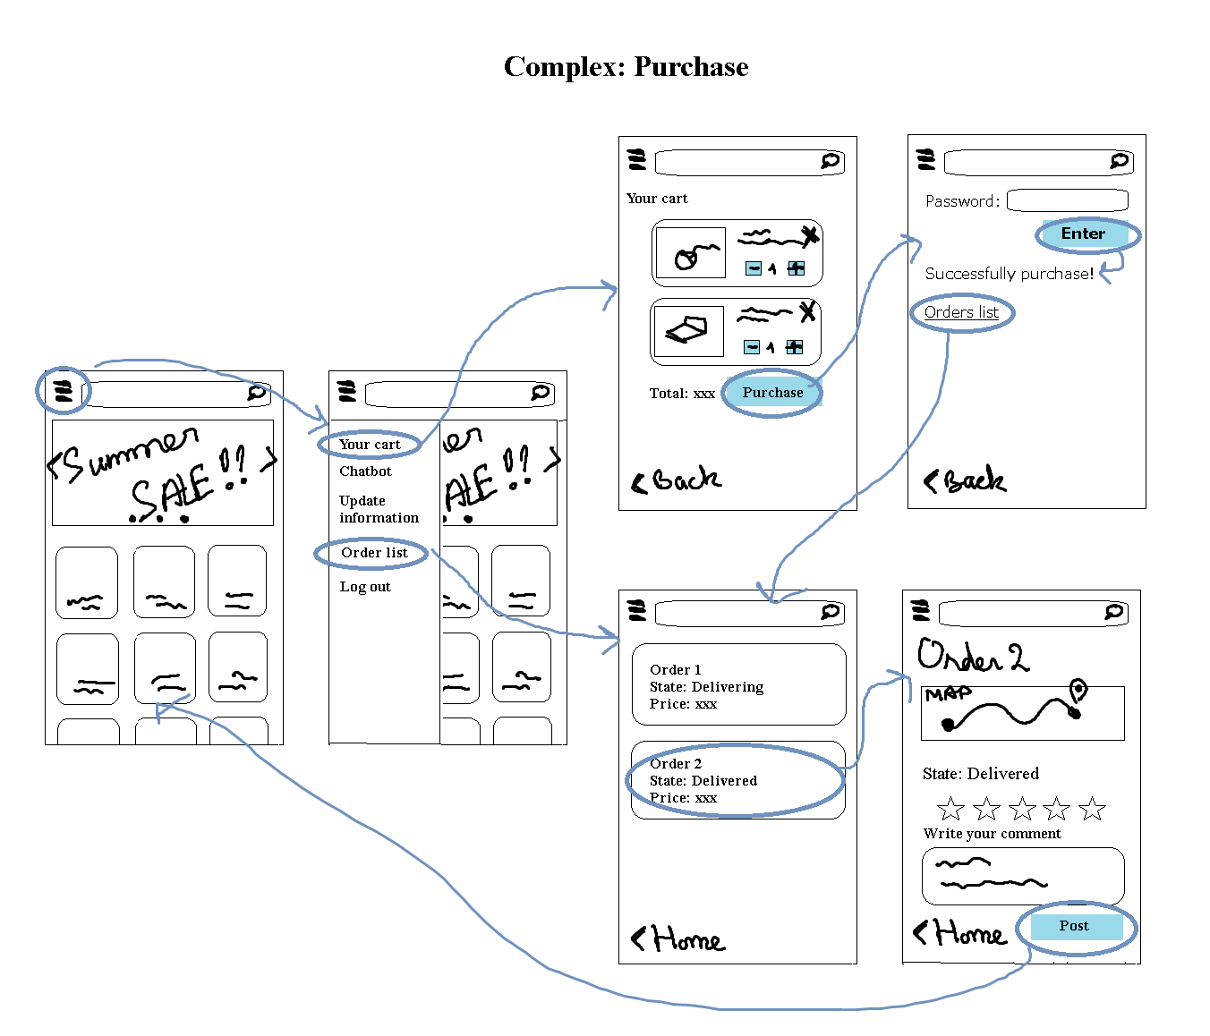
Complex: Purchase product

Slide 28
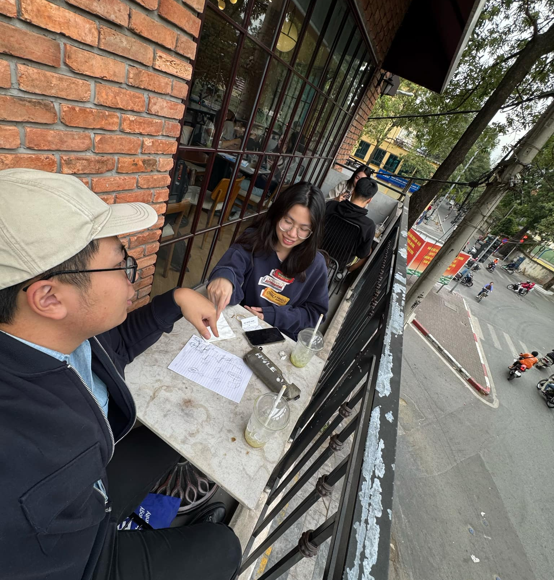
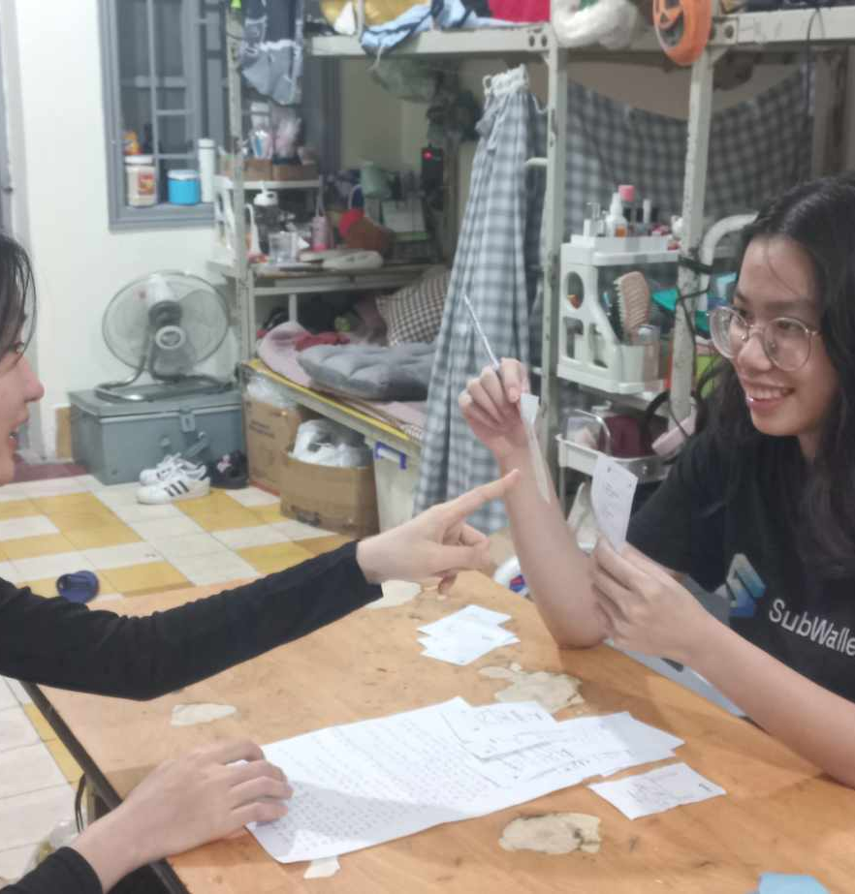
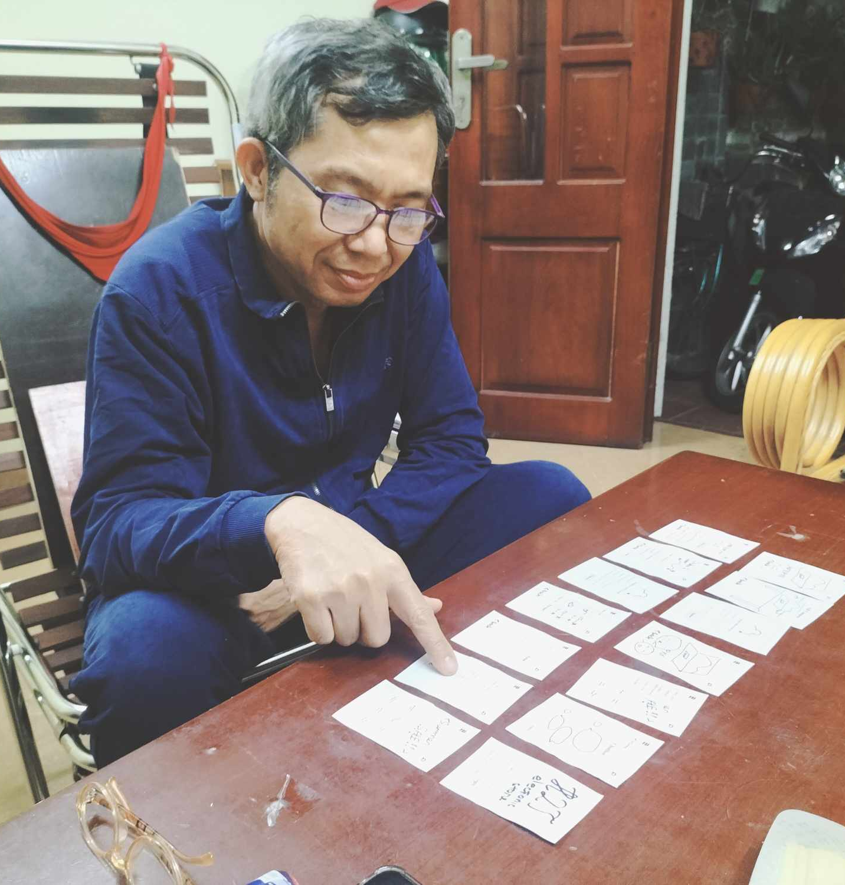
Prototype Participants

Slide 29

Testing results
What worked:
Concerns:
Seamless Navigation
Clear Product Details
Smooth Checkout Process
Chatbot Limitations & Privacy
Visual Clarity
Loading Speed
Key Measurement Results:
1. Response Time: average of 30s, Moderate < Simple < Complex
2. Complex tasks have a high error rate
3. The duties' thought process was well stated

Slide 30
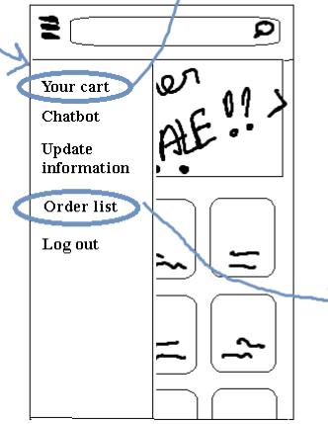
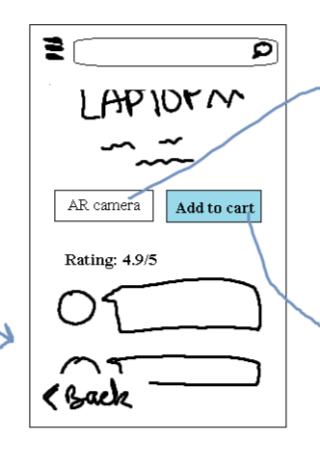
Possible UI Change
Navigation Bars
Navigation Bars
Clarify icons
Add option to sort product by category
Tutorial for AR camera
Multi languages

Slide 31
Summary
Shortcomings of usability test:
Beautiful theme
Manual test
Only English -> hard to understand
Not have many icons, only texts
Revising usability goals:
Make experience more intuitive
Add more languages and images for the webs

Slide 32
Med-Fi Prototyping
04

Slide 33
3 main adjustments
- Change the navigate bar from list to icons in the lowest bar
- Adding account page
- Adding forget password choice

Slide 34
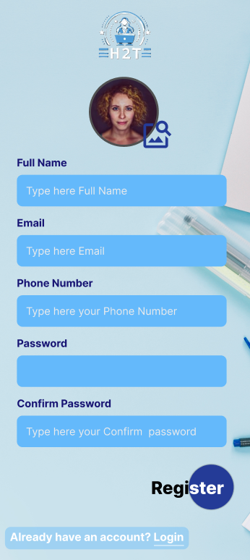

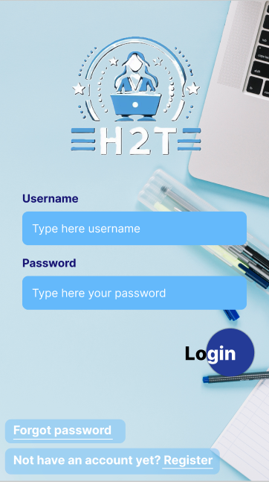
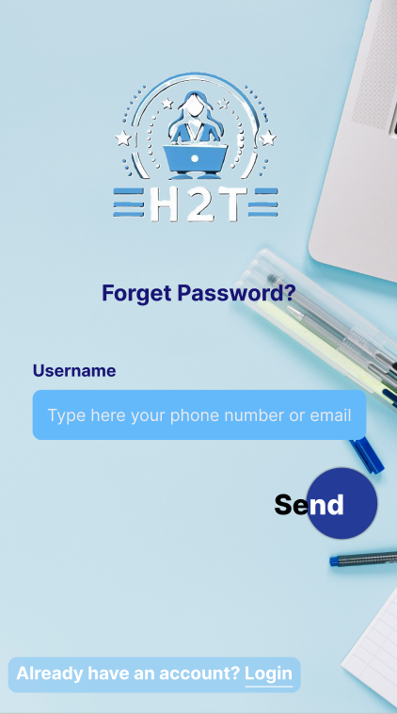

Med-Fi prototype constructions

Slide 35
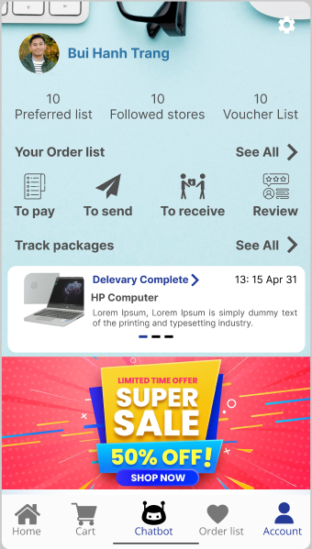
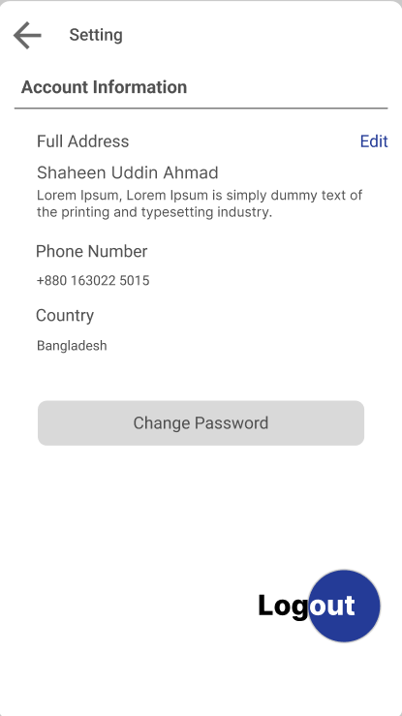
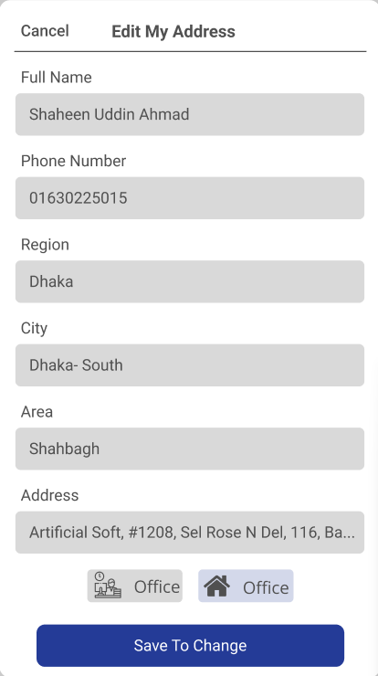
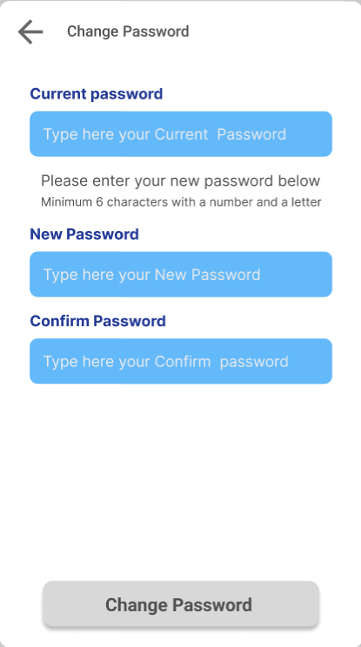
Med-Fi prototype constructions

Slide 36
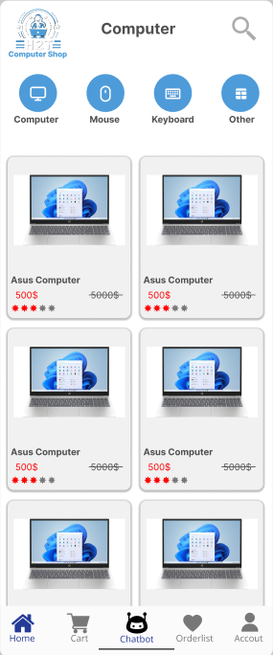
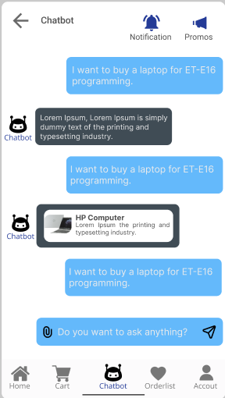
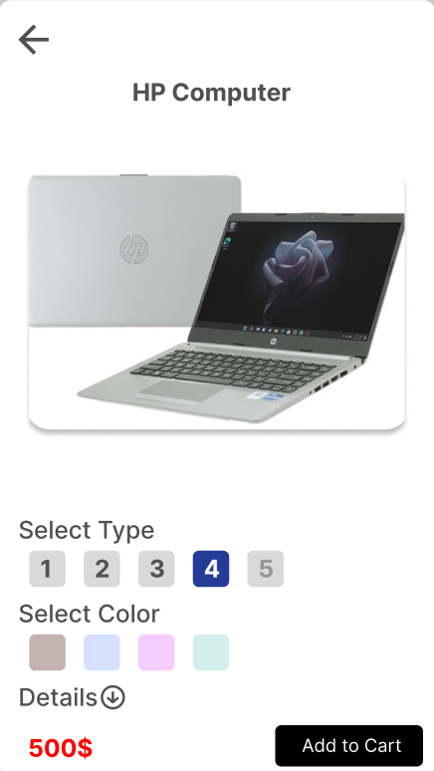
Simple: Chatbot

Slide 37
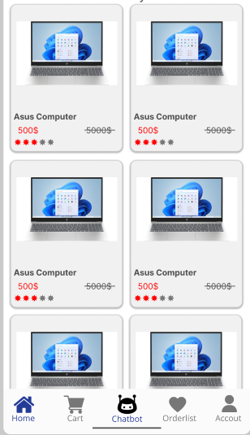

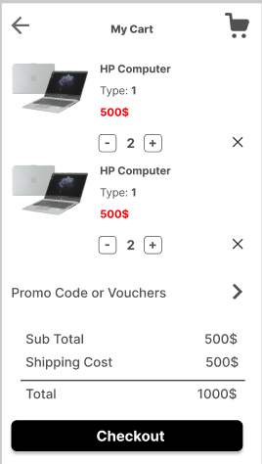
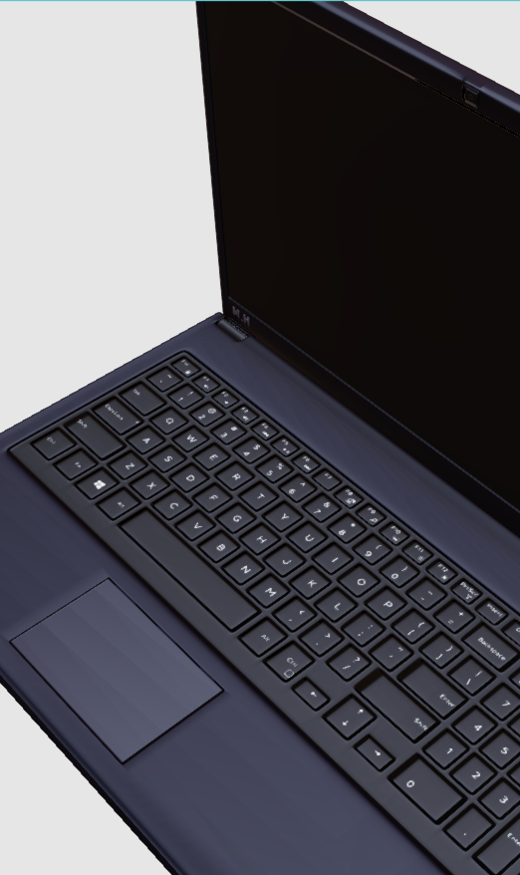
Moderate: View product

Slide 38
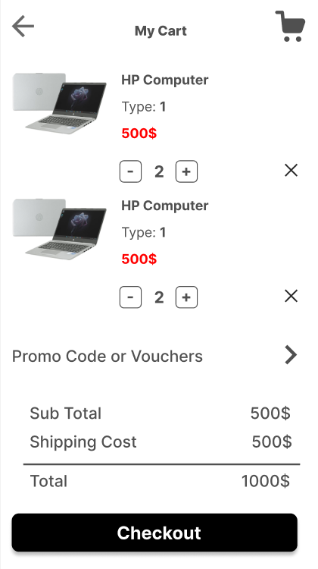
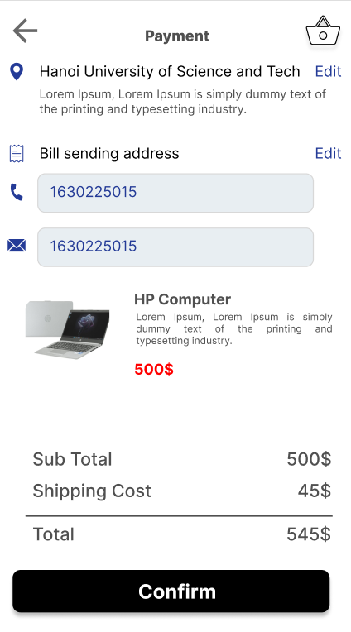
Complex: Purchase product

Slide 39
Thanks!

